Slide 1
Introduction to PHP

Slide 2
PHP
Originally, PHP stood for Personal Home Page. The acronym doesn't mean much anymore, but officially it is called PHP: Hypertext Processor
PHP is a server-side processing language. The server reads the PHP code and outputs browser-friendly HTML
With PHP you can store data on the server as files or in databases like MySQL.
PHP lets you build dynamic webpages that respond to input from users.

Slide 3
How to use PHP
In order to use PHP or any other server-side tool, you have two options:
Find a web host with PHP or other server-side tool support
Install a web server on your own PC, and then install PHP and other tools

Slide 4
1. Setting the environment
A web server
PHP
MySql
XAMP Server

Slide 5
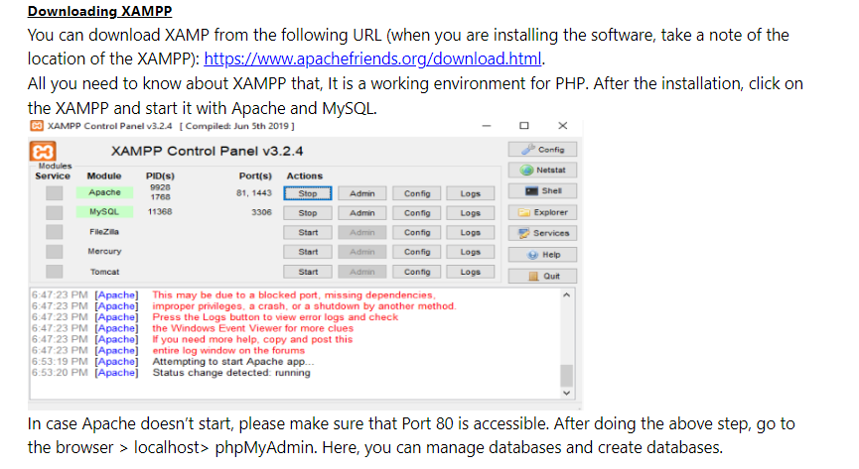

Slide 6
Xampp issues
while installation Xamp shows UAC error before installation
go to ms config and go to tools and launch change uac settings and set it to not notify
disable antivirus
After installation if mysql is not working change its port by following steps from following link
https://stackoverflow.com/questions/18022809/how-to-solve-error-mysql-shutdown-unexpectedly

Slide 7
Form Processing in PHP

Slide 8
Forms
Forms are special components which allow your site visitors to supply various information on the HTML page.
We have previously talked about creating HTML forms.
Forms typically include some input elements to gather information. We have also talked about client-side form validation using javascript.
This time we are going to talk about processing forms at server side using PHP.

Slide 9
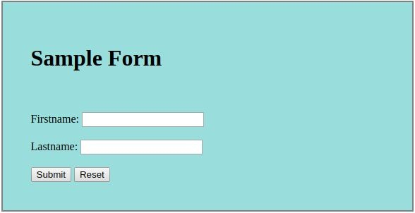
Forms
index.html
<form name="myForm" id="myForm">
<br><br>
<span id="firstname">Firstname: </span>
<input type="text" name="firstname"><br><br>
<span id="lastname">Lastname: </span>
<input type="text" name="lastname"><br><br>
<input type="submit" name="submitBtn">
<input type="reset" name="resetBtn">
</form>

Slide 10
Forms
HTML forms can have many attributes. Two of the most important attributes for HTML forms that we haven't talked about so far are:
action: The action parameter tells the browser what script/site must be called when the visitor presses the submit button.
method: The method parameter tells the browser by which method to send the user submitted data to the web-server. The parameter values are either POST or GET.

Slide 11
Forms GET vs. POST
Two ways the browser can send parameters to the web server
GET - Parameters are placed on the URL which is retrieved.
POST - The URL is retrieved and parameters are appended to the request in the HTTP connection.

Slide 12
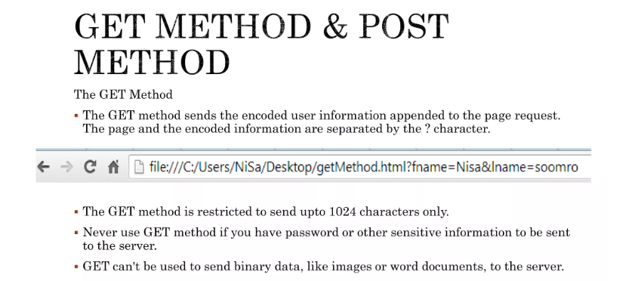

Slide 13
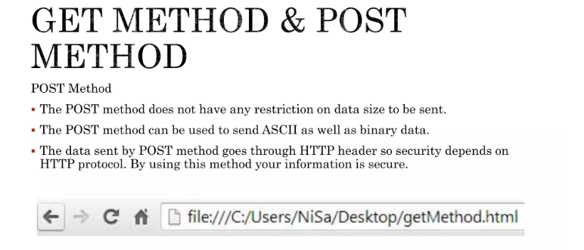

Slide 14
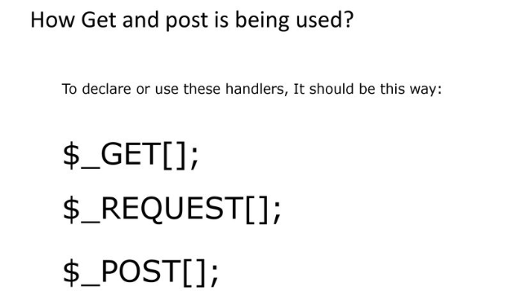

Slide 15
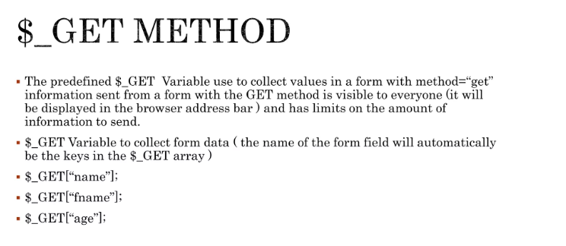

Slide 16
Forms
index.html
<form name="myForm" id="myForm" action="process.php" method="GET">
<br><br>
<span id="firstname">Firstname: </span>
<input type="text" name="firstname"><br><br>
<span id="lastname">Lastname: </span>
<input type="text" name="lastname"><br><br>
<input type="submit" name="submitBtn">
<input type="reset" name="resetBtn">
</form>
We are telling the browser to send form data to "process.php" file by using "get" method, upon form submission.

Slide 17
Accessing Form Data in PHP using GET
when the user enters information in the form and clicks the submit button, the form data will be sent to the PHP file specified by the action attribute
When GET method is used, form data will be saved in an array called $_GET
$_GET is an associative array, with the form field names used as the array keys and form field values stored as values
This array element holds the value
$_GET['firstname']
for firstname field in the form
$_GET['lastname']
This array element holds the value for lastname field in the form

Slide 18
Using Form Data in PHP
Once you know how to access form data in PHP, you can use it just like any other variable
In this example, we write a PHP function that welcomes the user to our web site.
process.php
<?php
function welcome($fname, $lname)
{
echo '<h1>Welcome ' . $fname . ' ' . $lname . '!</h1>';
}
welcome($_GET['firstname'], $_GET['lastname'])
?>

Slide 19
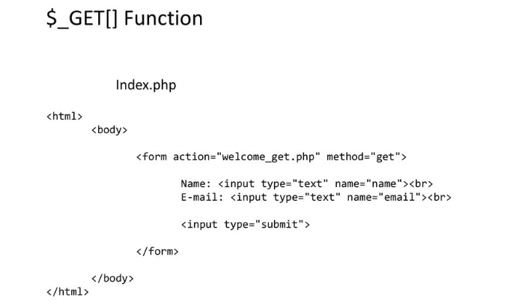
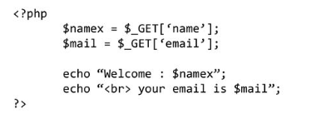

Slide 20
Example - $_GET
<html>
<body>
<form action="newpage.php" method="post">
Name: <input type="text" name="name">
Age: <input type="text" name="age">
<input type="submit">
</form>
</body>
</html>

Slide 21
Example - $_GET continued
<body>
Welcome <?php echo $_GET["name"];?>.<br/>
You are <?php echo $_GET["age"];?> years old
</body>

Slide 22
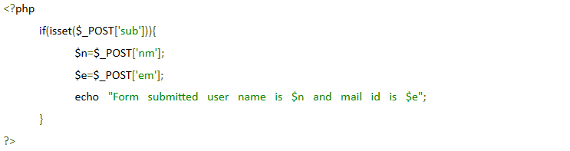
Isset function
The isset() function checks whether a variable is set, which means that it has to be declared and is not null.
This function returns true if the variable exists and is not null, otherwise it returns false.
USE $_GET HERE

Slide 23
method="POST"
The built-in $_POST array is used to collect values from a form sent with
method="post".
Information sent from a form with the POST method is invisible to others and has no limits on the amount of information to send.

Slide 24
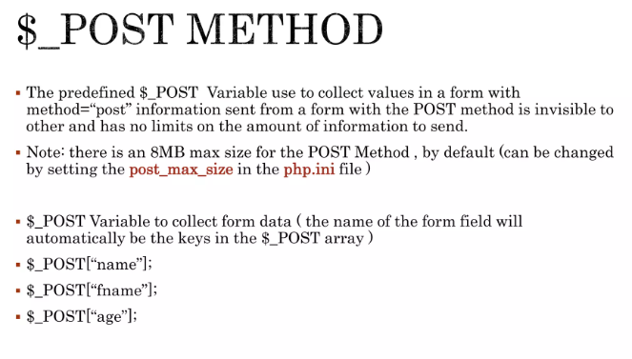

Slide 25
Form with method="POST"
index3.html
<form name="myForm" id="myForm" action="process2.php" method="POST">
<br><br>
<span id="firstname">Firstname: </span>
<input type="text" name="firstname"><br><br>
<span id="lastname">Lastname: </span>
<input type="text" name="lastname"><br><br>
<input type="submit" name="submitBtn">
<input type="reset" name="resetBtn">
</form>
We are telling the browser to send form data to "process.php" file by using "post" method, upon form submission.

Slide 26
Accessing Form Data in PHP using POST
when the user enters information in the form and clicks the submit button, the form data will be sent to the PHP file specified by the action attribute
When POST method is used, form data will be saved in an array called $_POST
$_POST is an associative array, with the form field names used as the array keys and form field values stored as values
This array element holds the value
$_POST['firstname']
for firstname field in the form
$_POST['lastname']
This array element holds the value for lastname field in the form

Slide 27
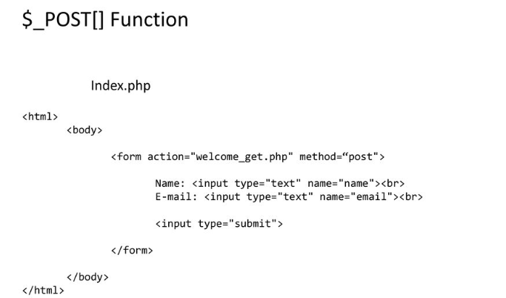
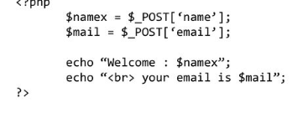

Slide 28
Using Form Data in PHP
Once you know how to access "POST" form data in PHP, you can use it just like any other variable
In this example, we write a PHP function that welcomes the user to our web site.
process2.php
<?php
function welcome($fname, $lname)
{
echo '<h1>Welcome ' . $fname . ' ' . $lname . '!</h1>';
}
welcome($_POST['firstname'], $_POST['lastname'])
?>

Slide 29
Example - $_POST continued
<html>
<head>
<title>Grab form values</title>
</head>
<body>
Welcome <?php echo $_POST["name"];?>.<br/>
You are <?php echo $_POST["age"];?> years old
</body>
</html>

Slide 30
Isset function
The isset() function checks whether a variable is set, which means that it has to be declared and is not null.
This function returns true if the variable exists and is not null, otherwise it returns false.

